Slide 1
Content Objective: Students will defend which future scenario they believe is most likely in relation to A.I. & Robotics.
Friday Dec. 6th
Unit 2 - Technical Basics of A.I.
Societal Impact of A.I. Creators
Potential Future Outcomes
Homework
No homework in the course. But I will make you think!

Slide 2
Scenario 1 - The Day the Yogurt Took Over
Scenario 2 - The Second Renaissance (warning: 9 min in - disturbing scene)
Scenario 3 - Sophia Talks About Her Plan
Let’s look at three different societal scenarios...categorize these as being either “evil,” “neutral,” or “good.” Come up with reasons why you feel these outcomes are good or bad and be ready to defend your thinking. Jot down significant moments that seem to go against (or with) your own ethical code.

Slide 3
Which Scenario do you believe is the most likely?
Get in a group of 2-3 and construct an argument for which one of these scenarios you believe is the most likely to play out in the future. Compare / contrast your ethical codes to help guide you. Write 2-3 paragraphs to defend your reasoning.
The goal of this course is to ensure that as the creators of Artificial Intelligence we have the power to determine which outcome we desire.
But if we can not come to an agreement on what we consider to be good or bad then AI might construct its own argument…is this dangerous?

Slide 4

Turn n’ Talk
Where do you place the worker who squashed the fly on your ethical spectrum (evil-good)? Why did you place it there?
Where do you place the robot women getting killed for fear of her killing her masters? Why did you place it there?
Of the three scenarios (Second Renaissance, Yogurt Taking Over, Sophia’s Utopian Dream) which do you think is the most likely? Why?

Slide 5
Class Ethical Data on Abortion
AI “Sees” Data / Used to Make Decisions
Should we make laws based on ethical data such as this?
17 Students Total
3 - No Opinion
2 - Good (save mother's life, prevent unwanted pregnancy, ease financial strain, prevent damaging foster care placement)
1 - Evil (should never take a life, except in matters of rape, mother endangerment)
12 - Neutral (Difficult choice for any mother, ¼ women get one at some point in their lifetime, most are already married and have children)
More on AI using Data to make choices tomorrow!

Slide 6
What is AI actually?

Slide 7
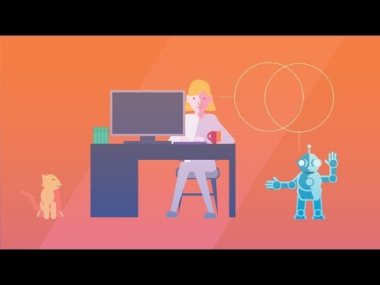
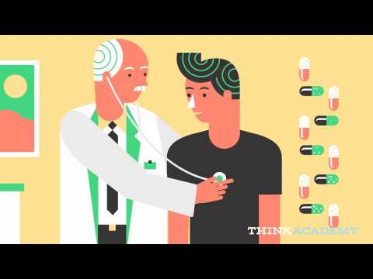
What is AI Wrap Up Video IBM Watson

Slide 8
How does a computer “see”?
Edge Detection Cat Slides

Slide 9
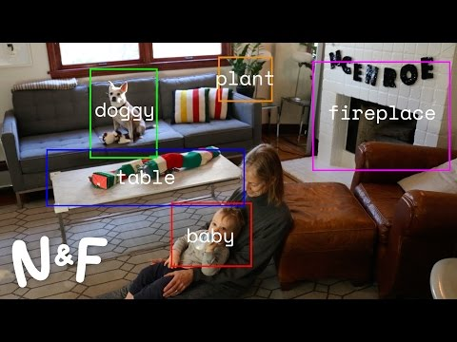
Computer Vision

Slide 10
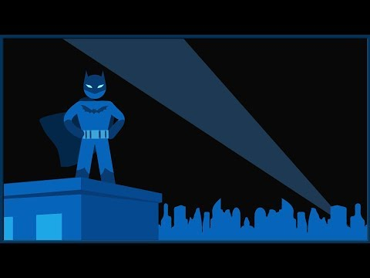
The “Gray Jedi Code” has a real name...

Slide 11
Day 1 - Social Impact
Why is it important to consider ethics and AI?
What is society? What do we view as being a good or bad society?
Who are the ones making the machines? Programming the machines? As we will learn later on, AI learns from us...are we always a good example?
See Hanson Robotics Website ----> Sophia
What might the ethical code of these people be as they create this robot?
Do you think they have similar or different ethics to us here in the classroom?

Slide 12
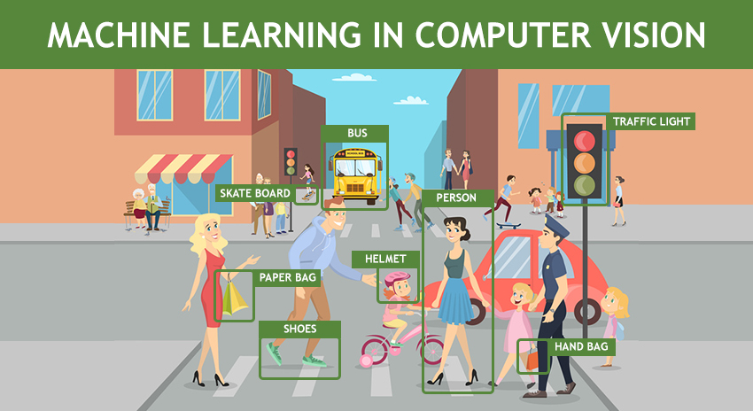

Tomorrow - Perception
What is Artificial Intelligence actually?
Computer Vision
How does a computer “see”?
Ethics of Perception

